Slide 1
Do not want to be considered for CY25 Promotion? Create a CRM case! GUIDE TO CREATE A CRM CASE
SOLDIER’S GUIDE

Slide 2
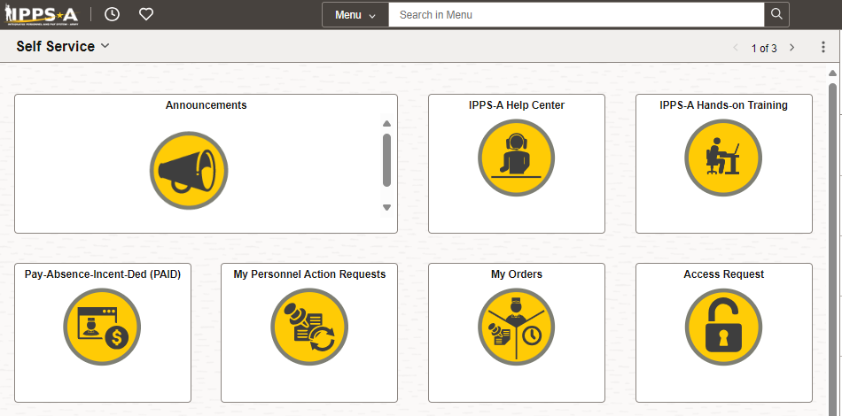
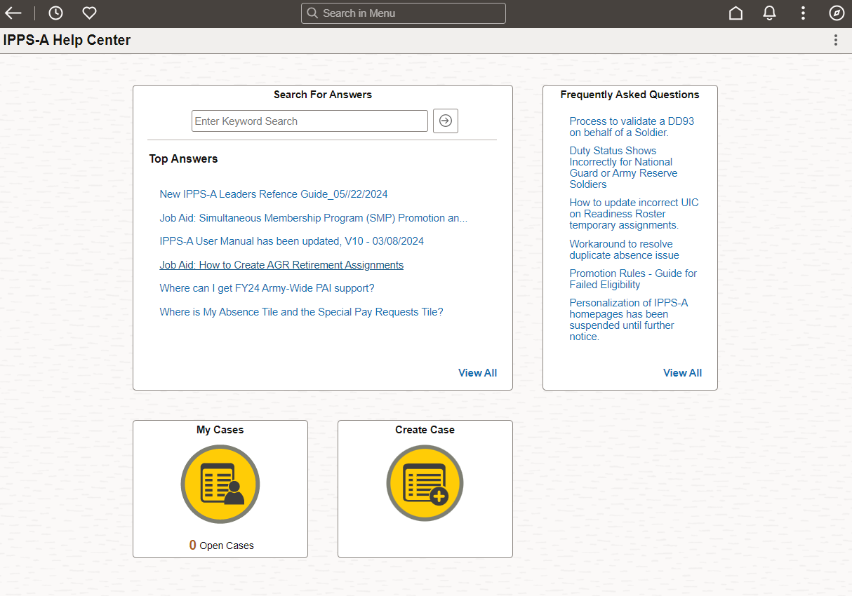
 Self Service
Navigate to the IPPS-A Help Center page under Self Service.
Scroll down to locate the Create Case tile.
Click the Create Case tile.

Slide 3
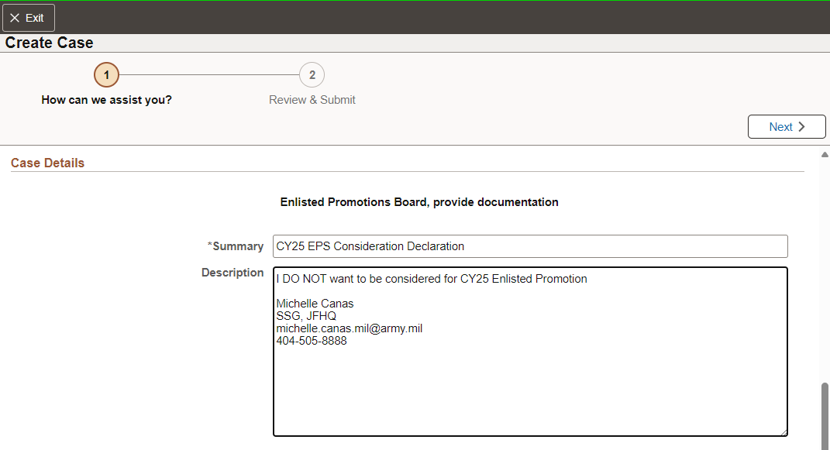
 Self Service
Select NO for “Does this issue impact your pay?”
Click the Category, select Promotions & Selections.
Click the Type, select Enlisted.
Click the Detail, select Promotion Boards.
Under Summary, enter the following,
“CY25 EPS Consideration Declaration”
Under Description, enter declaration
“I DO NOT want to be considered for CY25 Enlisted Promotion
Michelle Canas
SSG, JFHQ
michelle.canas.mil@army.mil
404-505-8888”
Click NEXT

Slide 4
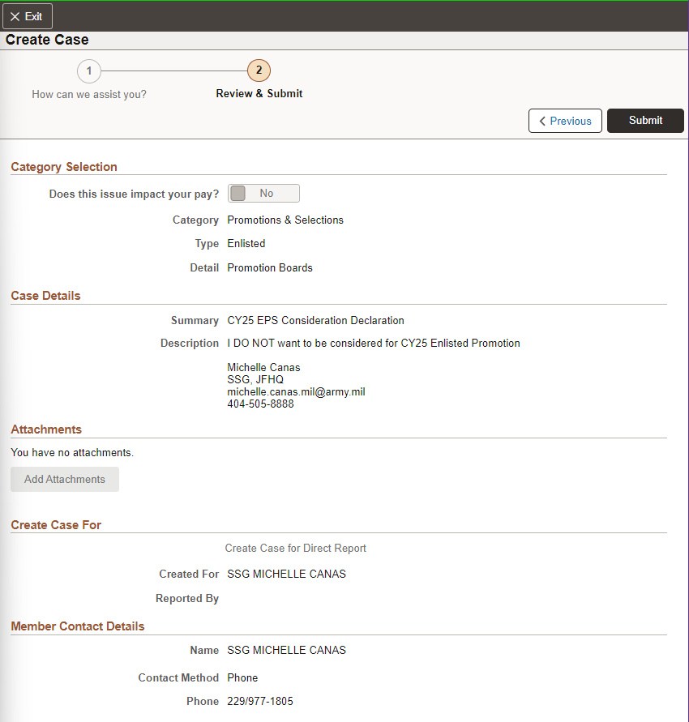
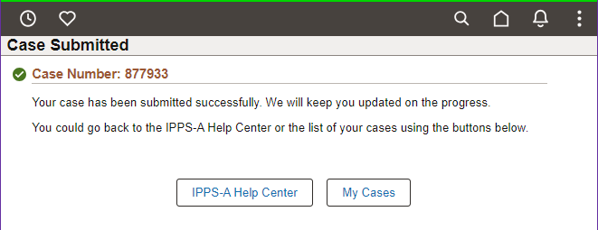
 Self Service
Review to make sure content is ready for submission
Click Submit
You will be provided with Case Number. Your request will be submitted to your S1 Pool.
Track progress of your submission by clicking My Case

